Slide 1
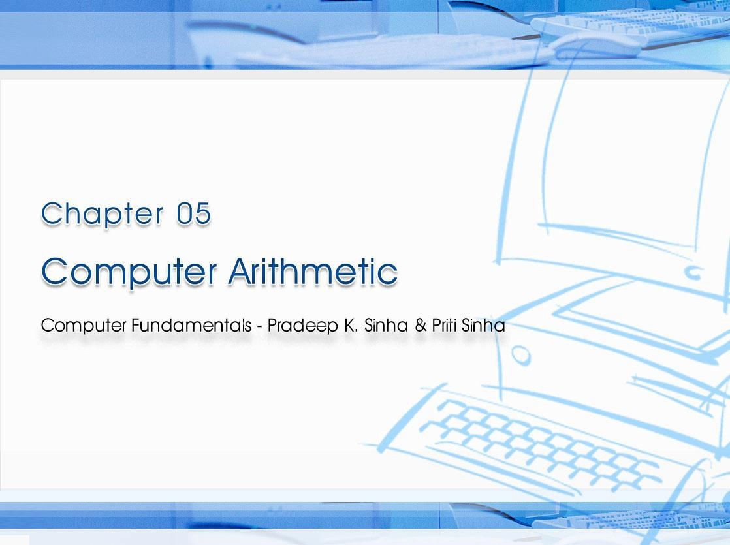
CCoommppuutterer FFununddaammenenttaallss:: PPrradadeeeepp KK.. SSiinhnhaa && PPrriititi SSiinhanha
Ref Page Chapter 5: Computer Arithmetic Slide 1/29

Slide 2
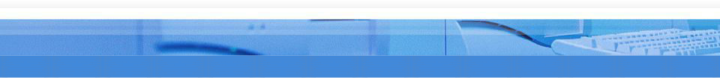
Computer Fundamentals: Pradeep K. Sinha & Priti Sinha
Learning Obj ect ives
I n this chapter you w ill learn about:
§ Reasons numbers
for using
binary
instead
of decimal
§ Basic arithmetic operations using binary numbers
§ Addition (+)
§ Subtraction (-)
§ Multiplication (*)
§ Division (/)
49

Slide 3
Computer Fundamentals: Pradeep K. Sinha & Priti Sinha
Binary over Decim al
§ Information is handled in electrical components
a computer
by electronic/
§ Electronic components operate in binary mode (can only indicate two states – on (1) or off (0)
§ Binary number system has only two digits (0 and 1), and is suitable for expressing two possible states
§ In binary system, computer circuits only have to handle two binary digits rather than ten decimal digits causing:
§ Simpler internal circuit design
§ Less expensive
§ More reliable circuits
§ Arithmetic rules/processes possible with binary numbers
49

Slide 4

Computer Fundamentals: Pradeep K. Sinha & Priti Sinha
Exam ples of a Few Devices t hat w ork in Binary Mode
Binary State | On ( 1 ) | Off ( 0 )
Bulb
Switch
Circuit Pulse
50

Slide 5
Computer Fundamentals: Pradeep K. Sinha & Priti Sinha
Binary Ar it hm et ic
§ Binary arithmetic is simple to learn as binary number system has only two digits – 0 and 1
§ Following slides show rules and example for the four basic arithmetic operations using binary numbers
50

Slide 6
Computer Fundamentals: Pradeep K. Sinha & Priti Sinha
Binary Addit ion
Rule for binary addition is as follows:
0 + 0 = 0
0 + 1 = 1
1 + 0 = 1
1 + 1 = 0 plus a carry of 1 to next higher column
50

Slide 7
Computer Fundamentals: Pradeep K. Sinha & Priti Sinha
Binary Addit ion ( Exam ple 1 )
Exam ple
Add binary binary form
numbers
10011 and
1001
in both
decimal and
Solution
Binary
Decim al
carry 11 | carry | 1
10011 +1001 |  | 19 +9
11100 |  | 28
In this example, carry are generated for first and second columns
51

Slide 8
Computer Fundamentals: Pradeep K. Sinha & Priti Sinha
Binary Addit ion ( Exam ple 2 )
Exam ple
Add binary numbers 100111 and 11011 in both decimal and binary form
Solution
Binary
11111
100111
+11011
Decim al
The addition
of three 1s
can be broken up into two
steps. First, we
add only
carry
carry 1
39
two 1s giving 10 (1 + 1 =
10). The third 1 is now
to
+27
added to this result
obtain 11 (a 1 sum with a 1
carry). Hence, 1 + 1 + 1 = 1, plus a carry of 1 to next higher column.
1000010
66
51

Slide 9
Computer Fundamentals: Pradeep K. Sinha & Priti Sinha
Binary Subt ract ion
Rule for binary subtraction is as follows:
0 - 0 = 0
0 - 1 = 1 with a borrow from the next column 1 - 0 = 1
1 - 1 = 0
51

Slide 10
Computer Fundamentals: Pradeep K. Sinha & Priti Sinha
Binary Subt ract ion ( Exam ple)
Exam ple
Subtract 01110₂ from 10101₂
Solution
12
0202
10101
-01110
00111
Note: Go through explanation given in the book
52

Slide 11
Computer Fundamentals: Pradeep K. Sinha & Priti Sinha
Com plem ent of a N um ber
Number of digits in the number
C
=
_{B}n
-
1
- N
Complement of the number
Base of the number
The number
52

Slide 12
Computer Fundamentals: Pradeep K. Sinha & Priti Sinha
Com plem ent of a N um ber ( Exam ple 1 )
Exam ple
Find the complement of 37₁₀
Solution
Since the number has 2 digits and the value of base is 10,
(Base)^{n} - 1 = 10² - 1 = 99
Now 99 - 37 = 62
Hence, complement of 37₁₀ = 62₁₀
53

Slide 13
Computer Fundamentals: Pradeep K. Sinha & Priti Sinha
Com plem ent of a N um ber ( Exam ple 2 )
Exam ple
Find the complement of 6₈
Solution
Since the number has 1 digit and base is 8,
(Base)^{n} - 1 = 8¹ - 1 = 7₁₀ = 7₈
Now 7₈ - 6₈ = 1₈
Hence, complement of 6₈ = 1₈
the value of
53

Slide 14
Computer Fundamentals: Pradeep K. Sinha & Priti Sinha
Com plem ent of a Binary N um ber
Complement of a binary number can be obtained by transforming all its 0’s to 1’s and all its 1’s to 0’s
Exam ple
Complement of
1 0 1 1 0 1 0 is
0 1 0 0 1 0 1
Note: Verify by conventional complement
53

Slide 15
Computer Fundamentals: Pradeep K. Sinha & Priti Sinha
Com plem entary Method of Subt ract ion
I nvolves follow ing 3 steps:
Step 1: Find the complement
of the number you
are subtracting (subtrahend)
2: Add this to the number are taking away (minuend)
3: If there is a carry of 1,
Step
from
which you
Step
add it to obtain
the result; if there is no carry, recomplement the sum and attach a negative sign
Complementary subtraction is an additive approach of subtraction
53

Slide 16
Com plem entary Subt ract ion ( Exam ple 1 )
Computer Fundamentals: Pradeep K. Sinha & Priti Sinha
Exam ple:
Subtract 56₁₀ from 92₁₀ using complementary method.
Solution
Step 1:
Complement of 56₁₀
= 10² - 1 - 56 = 99 – 56 = 43₁₀
The result may be verified using the method of normal subtraction:
Step 2: 92 + 43 (complement of 56)
= 135 (note 1 as carry)
Step 3: 35 + 1 (add 1 carry to sum)
Result = 36
92 - 56 = 36
53

Slide 17
Com plem entary Subt ract ion ( Exam ple 2 )
Computer Fundamentals: Pradeep K. Sinha & Priti Sinha
Exam ple
Subtract 35₁₀ from 18₁₀ using complementary method.
Solution
Step 1:
Complement of 35₁₀
Step 3:
Since there is no carry,
re-complement the sum and attach a negative sign to
obtain the result.
= 10² - 1 - 35
= 99 - 35
= 64₁₀
Step 2: 18
+ 64
Result
= -(99 - 82)
= -17
(complement
of 35)
The result may be verified using normal subtraction:
82
18 - 35 = -17
53

Slide 18
Computer Fundamentals: Pradeep K. Sinha & Priti Sinha
Binary Subt ract ion Using Com plem ent ary Met hod ( Exam ple 1 )
Exam ple
Subtract 0111000₂ (56₁₀) from 1011100₂ (92₁₀) using complementary method.
Solution
1011100
+1000111 (complement of 0111000)
10100011
1 (add the carry of 1)
0100100
Result = 0100100₂ = 36₁₀
53

Slide 19
Computer Fundamentals: Pradeep K. Sinha & Priti Sinha
Binary Subt ract ion Using Com plem ent ary Met hod ( Exam ple 2 )
Exam ple
Subtract 100011₂ (35₁₀) from 010010₂ (18₁₀) using complementary method.
Solution
010010
+011100
(complement of 100011)
101110
Since there is no carry, we have to complement the sum and attach a negative sign to it. Hence,
Result = -010001₂ (complement of 101110₂)
= -17₁₀
54

Slide 20
Computer Fundamentals: Pradeep K. Sinha & Priti Sinha
Binary Mult iplicat ion
Table for binary multiplication is as follows:
0 x 0 = 0
0 x 1 = 0
1 x 0 = 0
1 x 1 = 1
55

Slide 21
Computer Fundamentals: Pradeep K. Sinha & Priti Sinha
Binary Mult iplicat ion ( Exam ple 1 )
Exam ple
Multiply the binary numbers 1010 and 1001
Solution
 | 1010 x1001 |  | Multiplicand Multiplier
 | 1010 |  | Partial Product
 | 0000 |  | Partial Product
 | 0000 |  | Partial Product
 | 1010 |  | Partial Product
 | 1011010 |  | Final Product
(Continued on next slide)
55

Slide 22
Computer Fundamentals: Pradeep K. Sinha & Priti Sinha
Binary Mult iplicat ion ( Exam ple 2 )
( Continued from previous slide..)
Whenever a 0 appears in the multiplier, a separate partial product consisting of a string of zeros need not be generated (only a shift will do). Hence,
1010 x1001
1010
1010SS
(S = left shift)
1011010
55

Slide 23
Computer Fundamentals: Pradeep K. Sinha & Priti Sinha
Binary Division
Table for binary division is as follows:
0 ÷ 0 = Divide by zero error 0 ÷ 1 = 0
1 ÷ 0 = Divide by zero error 1 ÷ 1 = 1
As in the decimal number system (or in any other number system), division by zero is meaningless
The computer deals with this problem by raising an error condition called ‘Divide by zero’ error
57

Slide 24
Computer Fundamentals: Pradeep K. Sinha & Priti Sinha
Rules for Binary Division
Start from the left of the dividend
Perform a series of subtractions in which the divisor is subtracted from the dividend
If subtraction is possible, put a 1 in the quotient and subtract the divisor from the corresponding digits of dividend
If subtraction is not possible (divisor greater remainder), record a 0 in the quotient
Bring down the next digit to add to the remainder
than
digits. Proceed as before in a manner similar to long division
57

Slide 25
Computer Fundamentals: Pradeep K. Sinha & Priti Sinha
Binary Division ( Exam ple 1 )
Exam ple
Divide 100001₂ by 110₂
Solution
0101
(Quotient)
110 |  |  | 100001 | (Dividend)
 |  |  | 110 | 1 | Divisor greater than 100, so put 0 in quotient
 |  |  | 1000 | 2 | Add digit from dividend to group used above
110 100 110 1001 11 |  |  |  | 3 | Subtraction possible, so put 1 in quotient
 |  |  |  | 4 | Remainder from subtraction plus digit from dividend
 |  |  |  | 5 | Divisor greater, so put 0 in quotient
 |  |  |  | 6 | Add digit from dividend to group
 |  |  |  | 0 7 Subtraction possible, so put 1 in quotient
11
Remainder
57

Slide 26
Computer Fundamentals: Pradeep K. Sinha & Priti Sinha
Addit ive Met hod of Mult iplicat ion and Division
Most computers use the additive method for performing multiplication and division operations because it simplifies the internal circuit design of computer systems
Exam ple
4 x 8 = 8 + 8 + 8 + 8 = 32
56

Slide 27
Computer Fundamentals: Pradeep K. Sinha & Priti Sinha
Rules for Addit ive Met hod of Division
§ Subtract the divisor repeatedly from the dividend until the result of subtraction becomes less than or equal to zero
§ If result of subtraction is zero, then:
§ quotient = total number of times subtraction was performed
§ remainder = 0
§ If result of subtraction is less than zero, then:
§ quotient = total number of times subtraction was performed minus 1
§ remainder = result of the subtraction previous to the last subtraction
58

Slide 28
Addit ive Method of Division ( Exam ple)
Computer Fundamentals: Pradeep K. Sinha & Priti Sinha
Exam ple
Divide 33₁₀ by 6₁₀ using the method of addition
Solution:
33 - 6 = 27
27 - 6 = 21
21 - 6 = 15
Since the result of the last subtraction is less than zero,
15 - 6 = 9
9 - 6 = 3
3 - 6 = -3
Quotient = 6 - 1 (ignore last subtraction) = 5
Total subtractions = 6
Remainder = 3 (result of previous subtraction)
58

Slide 29
Computer Fundamentals: Pradeep K. Sinha & Priti Sinha
Key W ords/ Phrases
§ Additive method of division
§ Additive method of multiplication
§ Additive method of subtraction
§ Binary addition
§ Binary arithmetic
§ Binary division
§ Binary multiplication
§ Binary subtraction
§ Complement
§ Complementary subtraction
§ Computer arithmetic
58

